Slide 1

YouTube Trends Analysis
This presentation explores how data analysis and machine learning can be harnessed to analyze YouTube's trending videos and predict their potential for virality.
Tools used:
Python , Pandas , NumPy , Scikit-learn , Matplotlib

Slide 2
Introduction
YouTube is a widely used video-sharing platform where only a few videos gain high popularity and become trending. This project analyzes YouTube trending video data using data analytics and machine learning techniques to understand the factors influencing video popularity. By examining engagement metrics such as likes, comments, and categories, the project aims to predict video views and provide data-driven insights for content optimization.

Slide 3

The Challenge: Predicting Video Popularity
A Complex Equation
Predicting video popularity is inherently challenging due to a multitude of influencing factors,
Content creators often lack the data-driven insights to maximize reach.
Manual analysis is inefficient for datasets
Our core challenge: To analyze YouTube trending video data and predict video views using machine learning models

Slide 4
Dataset Overview: A Glimpse into YouTube's Pulse
Comprehensive Data
Real-World Behavior
Rich Features
Our dataset comprises extensive information on YouTube trending videos, providing a rich foundation for analysis.
Collected from publicly available sources, this data accurately reflects real-world YouTube user behavior and engagement.
The dataset includes a diverse mix of both numerical and categorical features, capturing various aspects of video performance.

Slide 5





Key Features: Driving Predictive Power
Likes
A direct measure of audience approval.
Dislikes
An indicator of audience dissatisfaction.
Comment Count
Reflects audience engagement and discussion.
Category ID
Categorizes video content, influencing viewership.
Publish Time
Temporal factor impacting initial reach.
Trending Date
When the video achieved trending status.
Target Variable: Views

Slide 6
Exploratory Data Analysis: Unveiling Insights
Data Cleaning
Visual Analysis
Feature Correlation
Thoroughly cleaned the dataset to address missing values and eliminate duplicate entries, ensuring data integrity.
Visualized the intricate relationships between video views, likes, and comments to identify underlying patterns.
Utilized plots and heatmaps to analyze the correlations between various features, highlighting significant dependencies.
Key Observations:
Videos garnering higher likes and comments consistently achieve more views. The distribution of views is highly skewed,

Slide 7
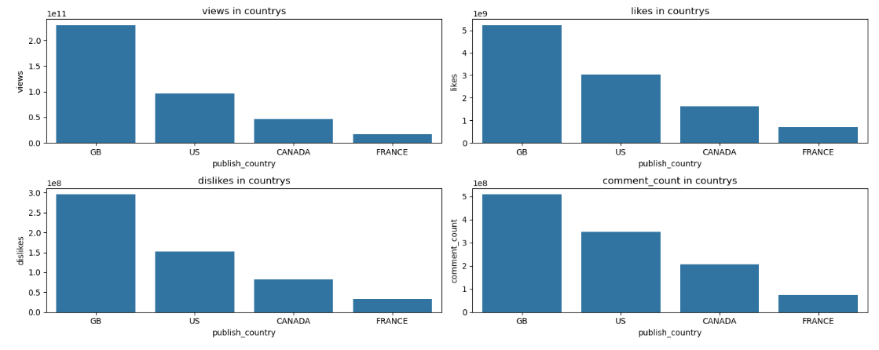
YOUTUBE ENGAGEMENT ANALYSIS BY COUNTRY
Great Britain (GB) leads across all engagement metrics (views, likes, dislikes, and comments), indicating the highest audience reach and interaction.
The United States (US) ranks second, showing strong but comparatively lower engagement than GB.
Canada and France have significantly lower engagement levels, suggesting a smaller or less active audience base.

Slide 8
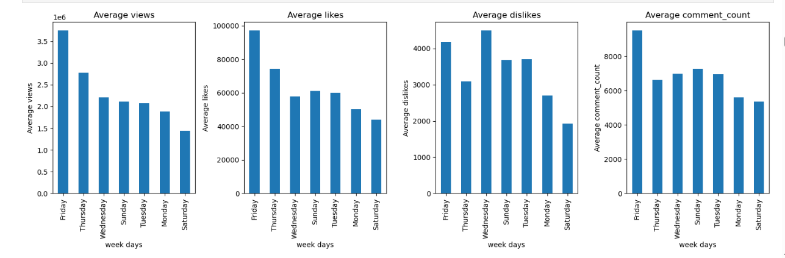
DAY-WISE ANALYSIS OF YOUTUBE ENGAGEMENT METRICS
Friday shows the highest average engagement across views, likes, dislikes, and comments, making it the best day to publish videos.
Thursday and Wednesday also record strong engagement, indicating higher audience activity during mid-to-late weekdays .
Saturday has the lowest engagement, while early weekdays and Sunday show moderate performance.

Slide 9
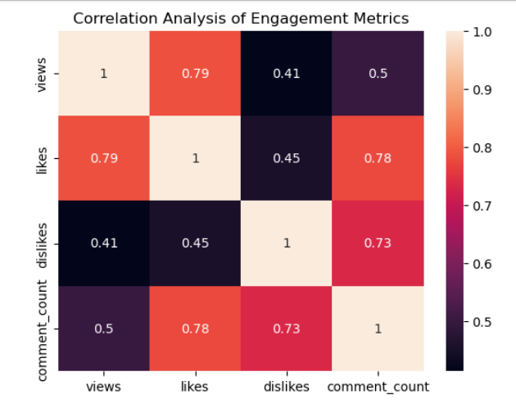
ENGAGEMENT METRICS CORRELATION HEATMAP
Views show a strong positive correlation with likes (0.79), indicating that higher view counts generally lead to increased audience appreciation.
Likes and comment count are strongly correlated (0.78), suggesting that videos receiving more likes tend to generate more user discussions.
Dislikes have a moderate relationship with views and comments, showing that highly engaging or controversial content often triggers both positive and negative interactions.

Slide 10
Models and Results: Benchmarking Performance
Linear Regressor
Gradient booster
XGBooster
Decision Tree Regressor
Random Forest Regressor
Ridge Regressor
Key Results
Our evaluation revealed that tree-based models consistently outperformed traditional linear models. Specifically, the Random Forest Regressor achieved the best overall performance, demonstrating superior predictive accuracy for YouTube video views.
Evaluation Metrics
R² Score
RMSE (Root Mean Squared Error)
MAE (Mean Absolute Error)

Slide 11
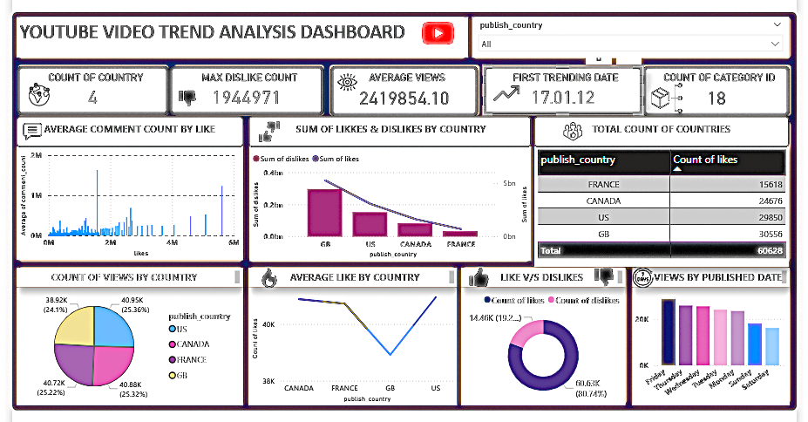
Interactive Dashboard: Visualizing Performance

Slide 12

Conclusion: Key Takeaways
Engagement Drives Views
ML for Prediction
Metrics such as likes and comments are crucial indicators, significantly impacting a video's overall view count.
Machine learning models provide an effective and scalable solution for predicting YouTube video popularity.
XGBoost Superiority
Objectives Achieved
Among the evaluated models, XGBoost Regressor consistently delivered the highest accuracy.
The project successfully met its objectives, demonstrating the power of data analysis in understanding YouTube trends.

Slide 13
Future Scope: Expanding Predictive Horizons
Sentiment Analysis
Integrate sentiment analysis on video titles and comments .
Thumbnail Analysis
Incorporate analysis of thumbnail images, recognizing their critical role in attracting viewer
Real-Time Data
Utilize the YouTube API for real-time data integration.
Deep Learning Models
Apply deep learning architectures to improve accuracy further.
Content Strategy & Recommendation
Extend the system to provide personalized recommendations and
strategic guidance for content creation.

Slide 14

Thank You!
Questions?
We welcome your questions and feedback on our data-driven approach to understanding YouTube trends.

